Slide 1

Project 1 – Analysis of mortgage stress by Geography in NSW Australia
Damien Nguyen, Nidal Sinan, Huirong Tracy Lao and Troy Cassels

Slide 2
Agenda
 | Section | Speaker | Time
1 | Introduction/Executive Summary | Troy | 5 mins
2 | Code Demo Data Clean-up Code run-through NSW total graphs Folium geospatial views | Damien | 15 mins
3 |  | Tracy
4 |  | Nidal
5 | Insights/Wrap-up | Troy | 5 mins

Slide 3
Motivation and Summary
Core Message/Hypothesis: Explain mortgage stress in New South Wales (NSW)
Motivation: Rapidly rising interest rates mean that mortgage stress is a significant issue. Mortgage stress defined as an excessive portion of income dedicated to mortgage payments
Link to Fin Tech – many online/digital home loan providers have emerged (e.g. Ubank, Unloan, etc) which would be interested in geographical areas of high mortgage stress.
Questions asked:
Characteristics of mortgage stress for NSW in aggregate
NSW regions with highest levels of mortgage stress
Drivers for mortgage stress
Summary of findings: Highest levels of mortgage stress are in Sydney and within Sydney the highest levels are in the Northern Beaches/Baulkham Hills and Hawksbury.

Slide 4
Data Used
NSW total metrics per Australian Bureau of Statistics (ABS) data
Geographic breakdowns – based on ABS average income and monthly mortgage payment info by region (Statistical Area 4) in NSW.
For selected areas – data has been analyzed at a lower level (Statistical Area 2)
Folium (new library) library used for Geospatial views
Data also used from the Reserve Bank of Australia (RBA) and Domain.

Slide 5
Code Demo

Slide 6
Data challenges/Postmortem
ABS website has many different ways to extract data which is confusing
ABS API difficult to use
Some APIs have a cost or take time to set-up
Data gaps exist in lower level ABS geographic data

Slide 7
Explanation for high mortgage stress
Income:
Higher income households can afford a higher portion of income on mortgage payments as a lower portion of their income is needed for essentials such as food.
Mortgage payments: Loan Amount x Interest rate
Property prices
Loan age for Amortising loans
Likely to be less of a driver – each geographic area assumed to have a similar distribution of rates

Slide 8
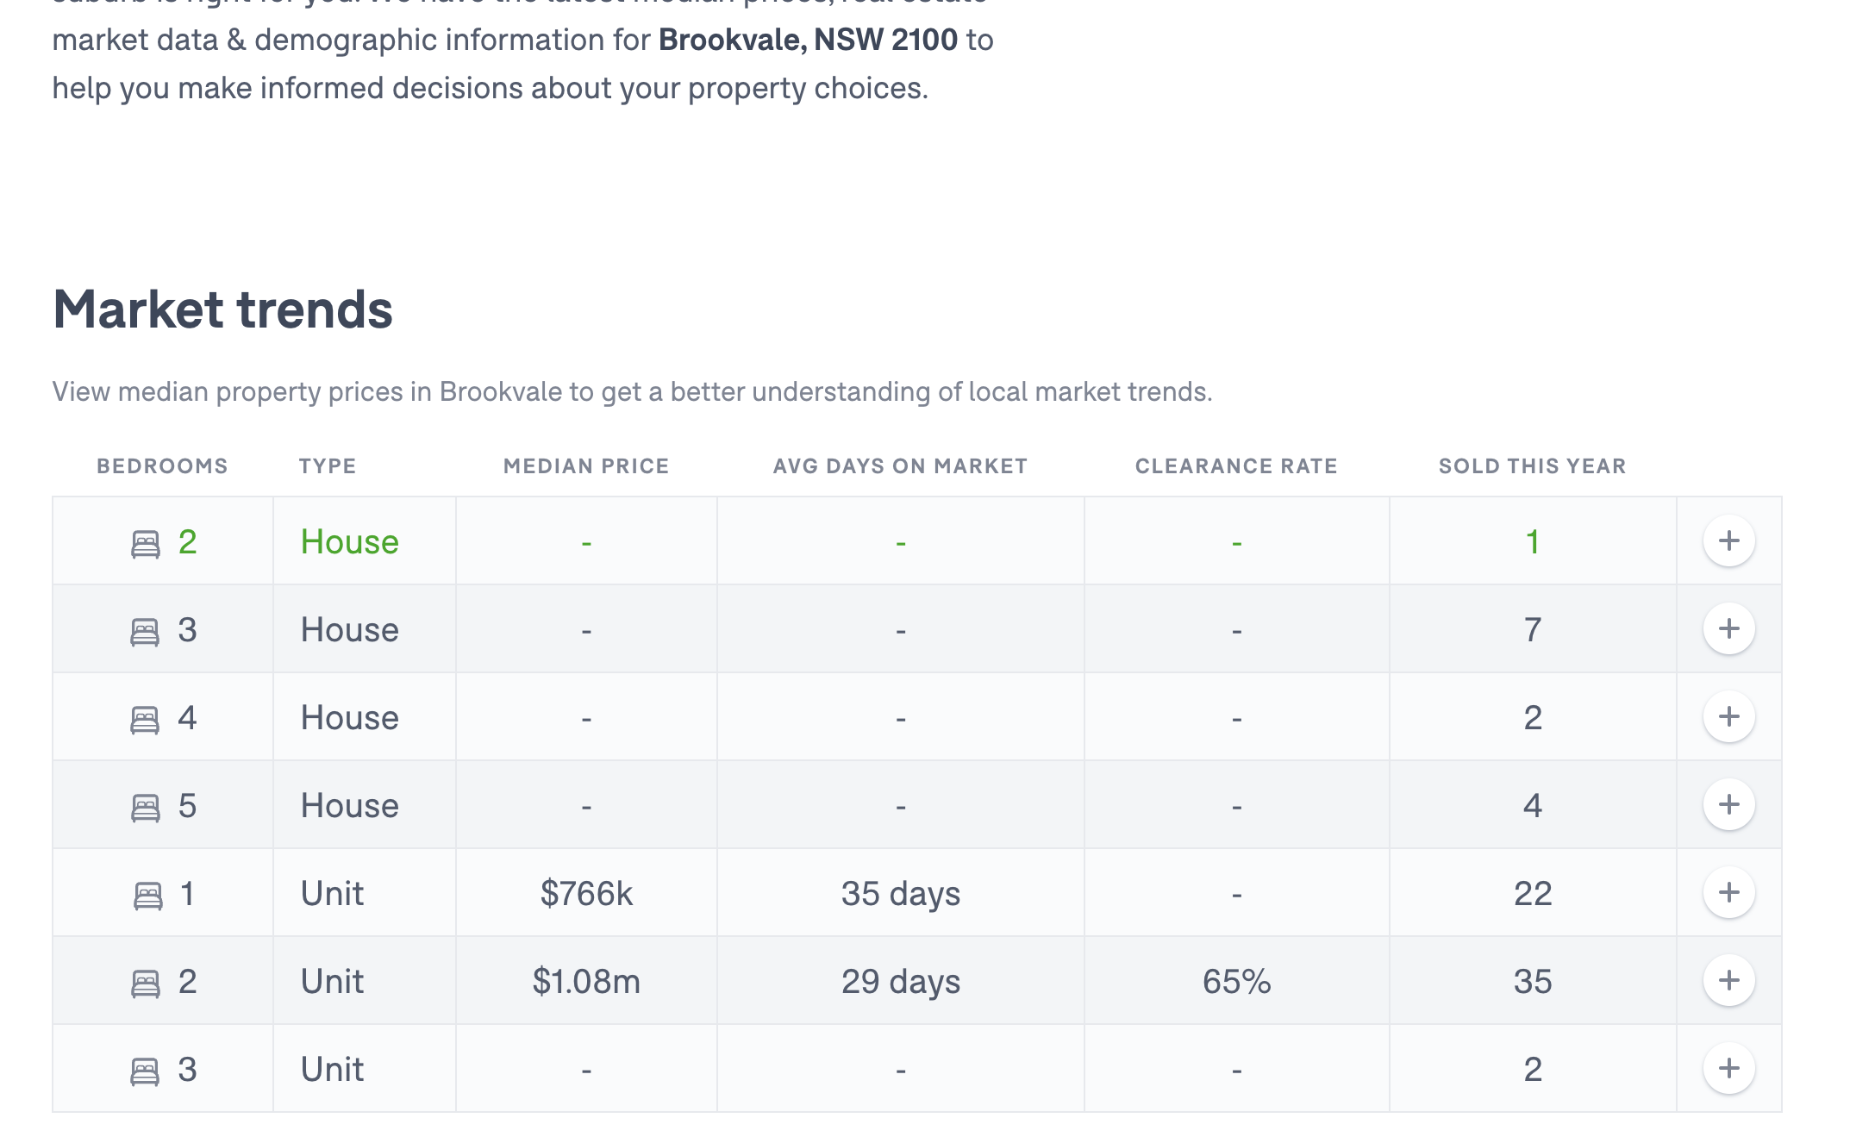
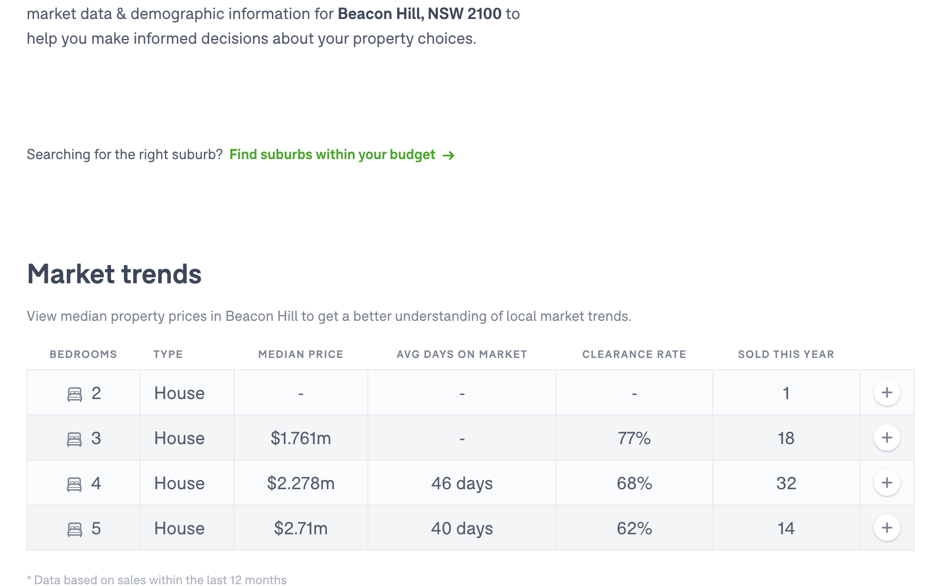
Northern Beaches – Domain Data
Lower stress
Higher stress
Areas with a higher portion of Units have lower mortgage stress – Units have lower property pries

Slide 9
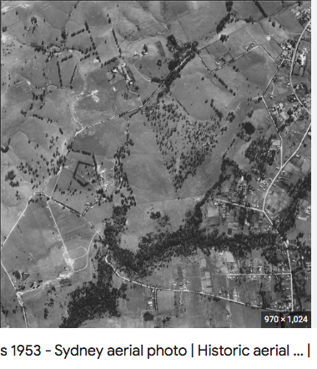
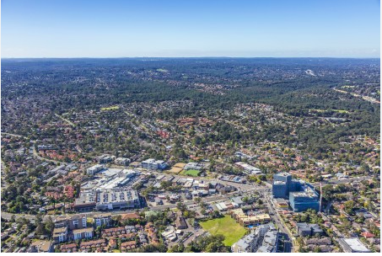
Baulkham Hills– Arial images
Areas with a higher portion of new developments would have loans of lower average loan age – i.e. higher loan amounts

Slide 10
Next Steps
Additional questions that surfaced
Need to understand/come up with work-arounds for data gaps in lower level (Stat area 2) data
Look for other drivers causing variations
Additional topics to research
Update analysis based on projected interest rate rises
Plan for future development
Provide tools to allow users to look-up mortgage stress based on other parameters such as post code or Local Government Area

Slide 11
Any Questions?

Slide 12
Links
GitHub repo https://github.com/Explictz/Project-1

